Slide 1
Bank Loan Case Study
Excel Hyperlink (CLICK HERE)
Created & Submitted by:
Anushka Jade

Slide 2
Project Description
Excel Hyperlink (CLICK HERE)
To perform EDA on the provided dataset and identify the patterns and trends that provides distinction between right and risky customers and in turn deliver insights on two key objectives:
Identify the right customers for loan approval.
Identify risky customers and use right approach to deal with those customers to prevent loan default.
For the data analysis & visualization, MS Excel shall be used for this project.

Slide 3


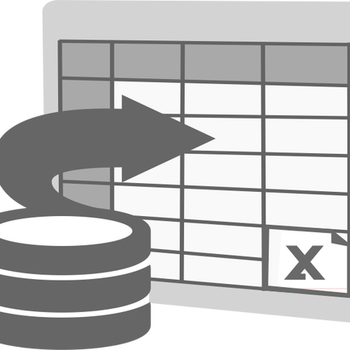


Approach
Understanding the provided Dataset & Risk analytics in Banking & Finance
Understanding the tasks and preparing data for the same
Performing data analysis and implementing excel functions based on given 5 tasks.
Using different graphs and charts to infer the data and analyze trends/correlation
Presenting the Insights

Slide 4
Understanding the Tasks
Given tasks for data analysis are as follows.
For each task, different excel functions & visualization methods will be used.
Identify Missing Data and deal with it appropriately
Identify Outliers in the Dataset
Analyze Data Imbalance
Perform Univariate, Segmented Univariate, and Bivariate Analysis
Identify Top Correlations for Different Scenarios

Slide 5
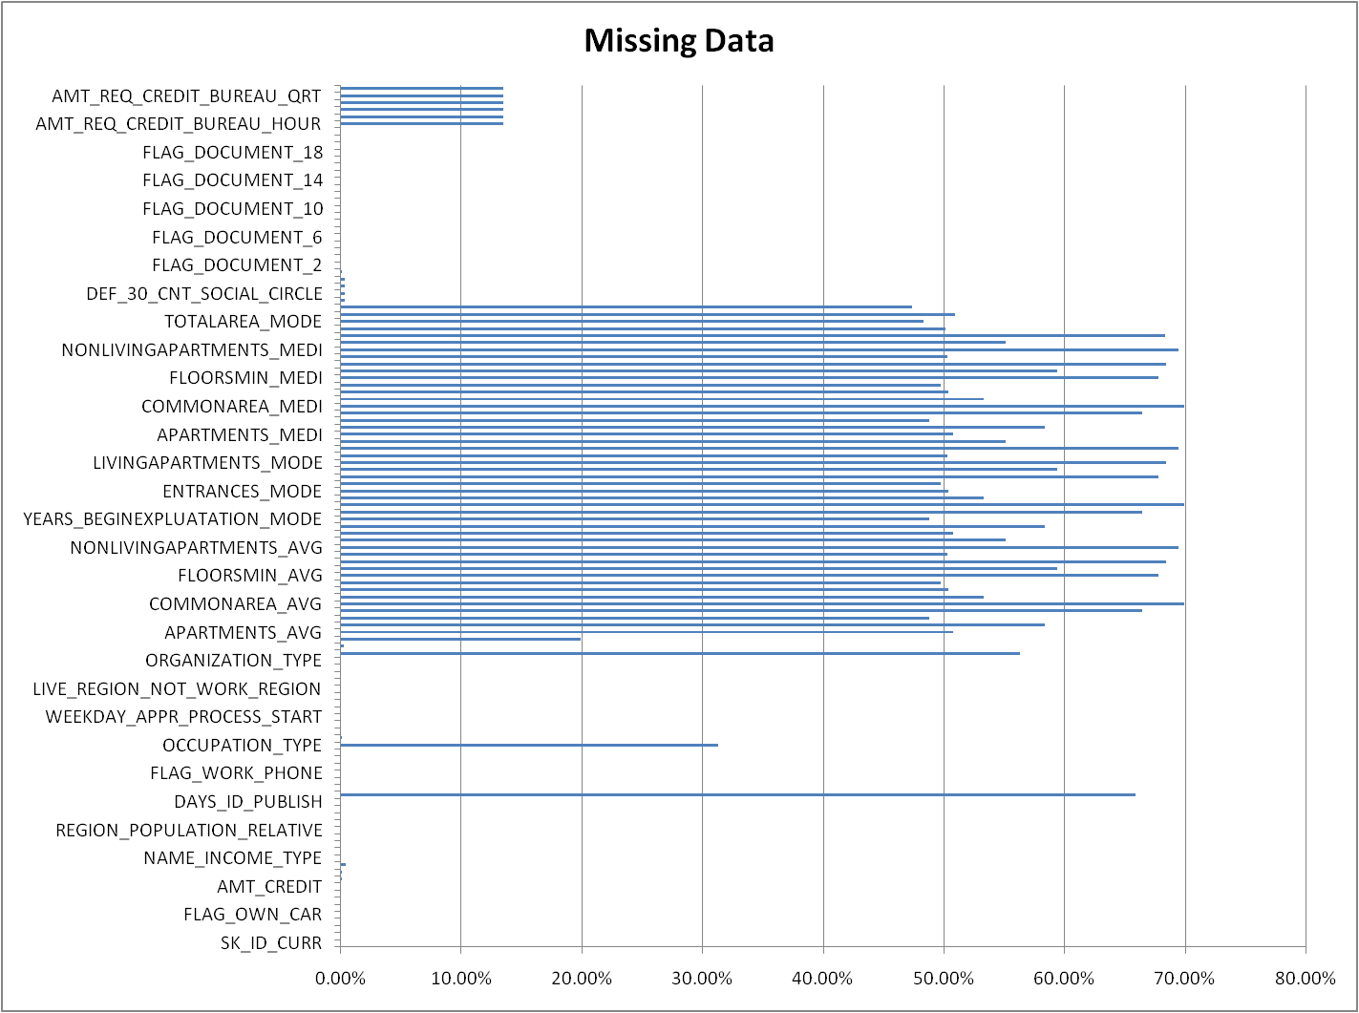
Identify Missing Data and deal with it appropriately
Performed EDA appropriately.
Used =CountA() to calculate total records for each column, =CountBlank() to calculate blank cells for each column.
Calculated the % value using =IF() to remove the columns that contained more than 30% blank values.

Slide 6
Identify Missing Data and deal with it appropriately
Here’s the chart of columns clearly crossing 30% bound, which were removed. 50 columns removed.
Other columns that were irrelevant to the analysis were removed.
New columns were added like Birth Years(Age), Employed Years, Registration Years.

Slide 7
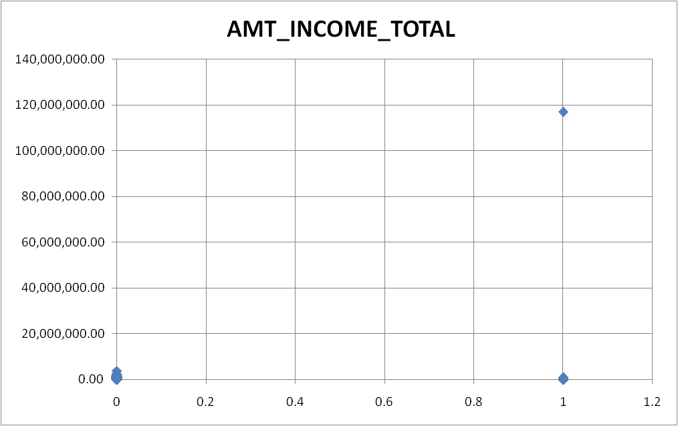
B. Identify Outliers in the Dataset
Descriptive statistics of Amt_Income total was calculated as well the Outliers with the help of Quartile() function in excel.
Also, as per the scatter plot, income value > 117000000 were considered to be outliers.
Hence, target 1 customers that with income of above >117000000 and still facing difficulty should be further investigated.

Slide 8
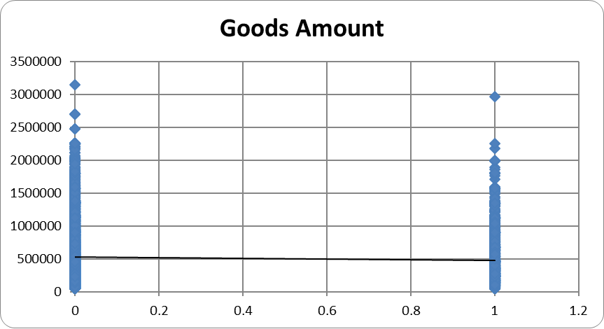

B. Identify Outliers in the Dataset
Descriptive statistics of Goods Amount (Loan amount needed by customer) was calculated as well the Outliers with the help of Quartile() function in excel.
Based on that, all the records containing Outliers were removed as it could influence the accuracy of data analysis.
Since the repayers vs defaulters show only a slightly higher outlier range, as per the scatter plot for Goods Price > 25,00,000 were considered to be outliers and showed risk in giving loan, hence need further investigation of the loan seeker.

Slide 9
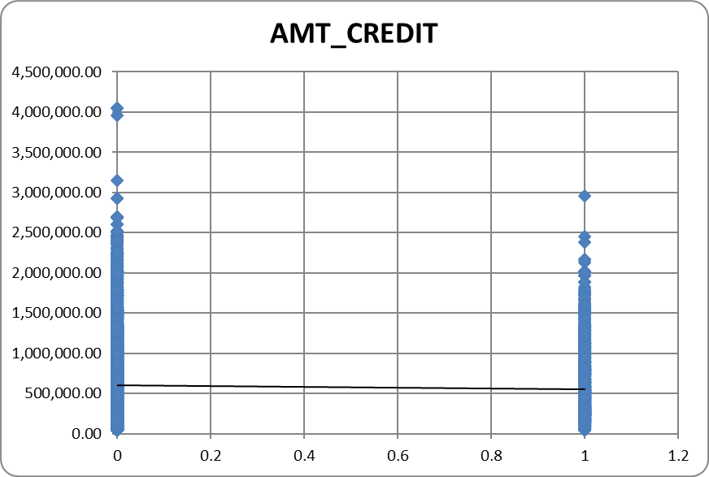
B. Identify Outliers in the Dataset
AMT_CREDIT (Loan amount credited to customers) was plotted in scatter chart against target (0/1) customers.
As per the findings, credited loan value > 29,00,000 is to potentially risky customers should be avoided, as well as crediting above this amount needs further investigation of the customer.
It’s also observed from the trendline, the credit amount to defaulters should be reduced further to avoid loan default.

Slide 10
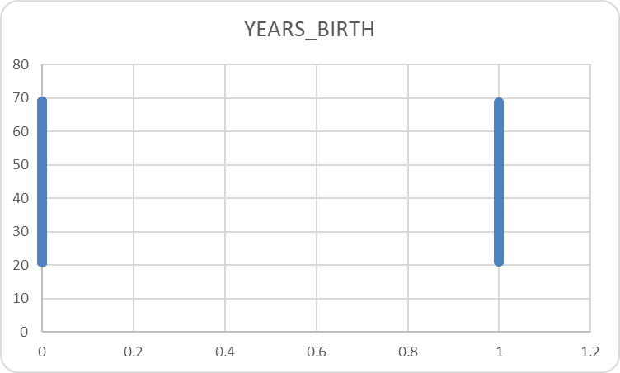
B. Identify Outliers in the Dataset
Years Birth( Age relative to loan application) shows no such signs of outliers, and hence doesn’t require further investigation based upon it.

Slide 11
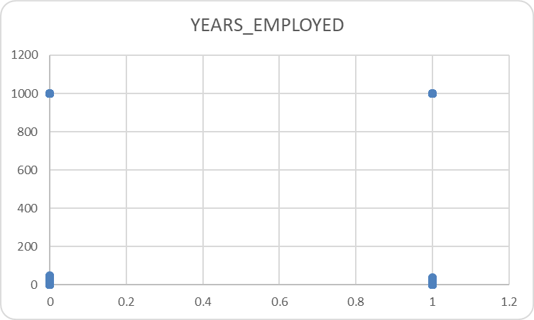
B. Identify Outliers in the Dataset
Years Employed being 1000 is not practical for any type of targets, and hence was considered as outliers which are to be not taken into consideration for any type of data analysis related to employment years (i.e., filtering out the data entries consisting of outliers of years_employed column).

Slide 12
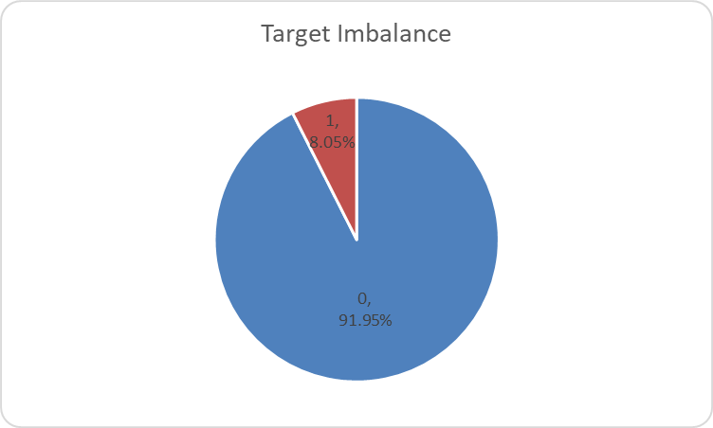
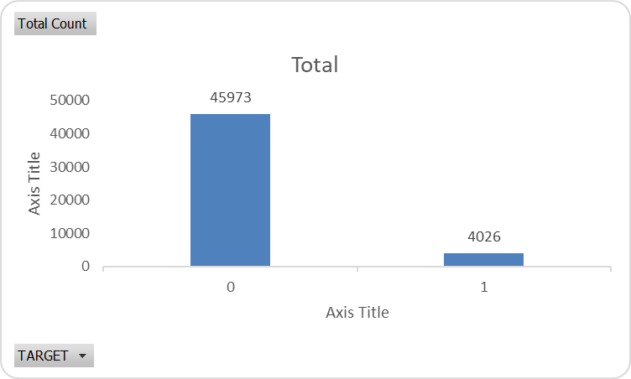
C. Analyze Data Imbalance
There’s a huge imbalance in Target 0 - 91.95% (Repayer) and Target 1 (Defaulter) - 8.05%.
Ratio: 11.41:1 (approx)

Slide 13
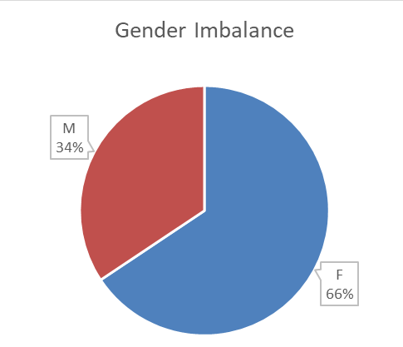
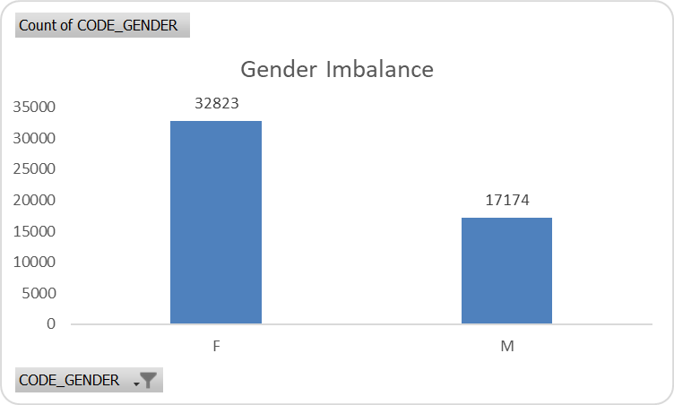
C. Analyze Data Imbalance
There’s a huge imbalance in Gender. Females (66%) have been observed to apply for more loan than Males (34%).
Ratio: 1.91:1 (approx) i.e., females are almost twice the males.

Slide 14
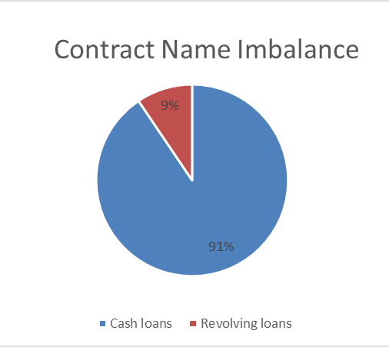
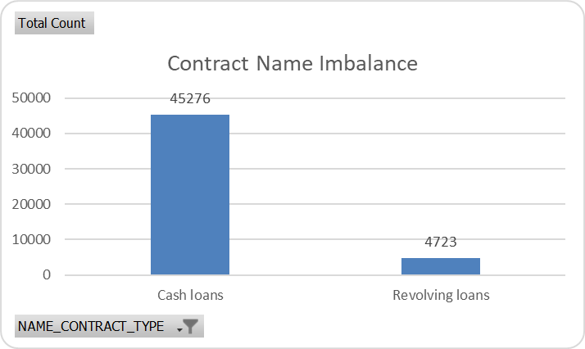
C. Analyze Data Imbalance
There’s a huge imbalance in Contract Name Type.
Revolving loans consists 91% of the customers, whereas Cash loans consist 9%.
Ratio: 9.58:1 (approx)

Slide 15
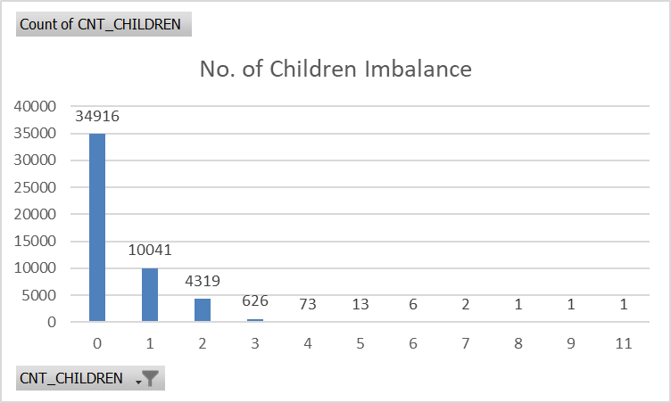
C. Analyze Data Imbalance
Most loan applicants are childless.
And the second most (albeit the huge difference) have only one child.

Slide 16
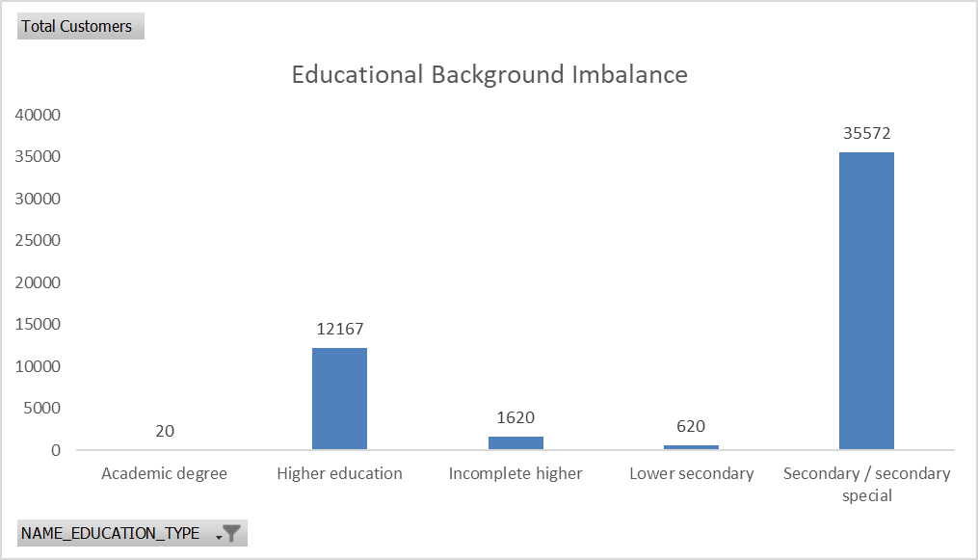
C. Analyze Data Imbalance
Most customers seeking out loan have only completed Secondary/Secondary special education, followed by Higher education as the second most completed educational level, and the least (extremely low) number of customers have academic degree.
Ratio between top 2: 3.48:1 (approx)

Slide 17
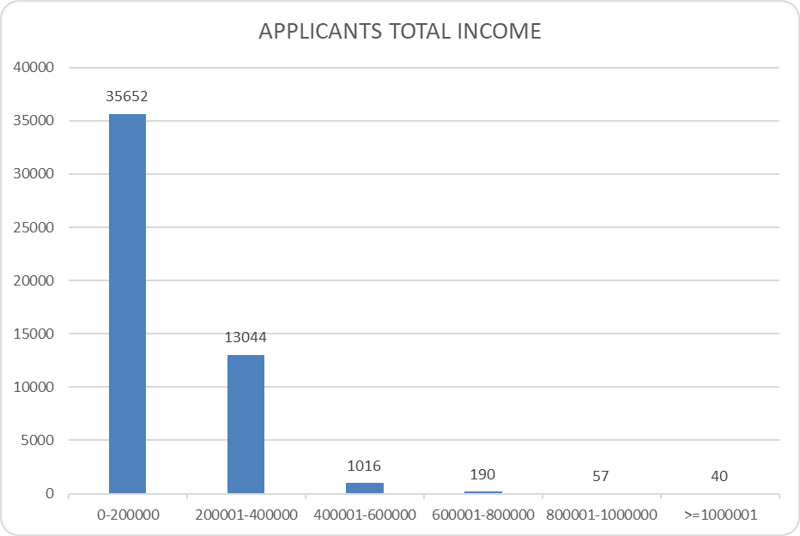
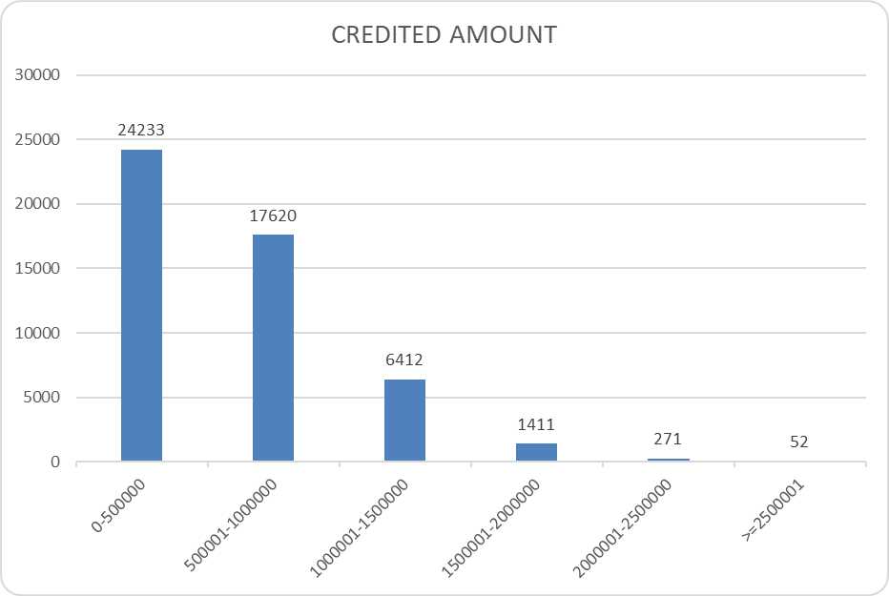
D. Perform Univariate, Segmented Univariate, and Bivariate Analysis
Most applicants have total income less than or equal to Rs. 2 Lakhs.
And most applicants have been credited with the loan amount less than or equal to Rs. 5 Lakhs.
UNIVARIATE ANALYSIS

Slide 18
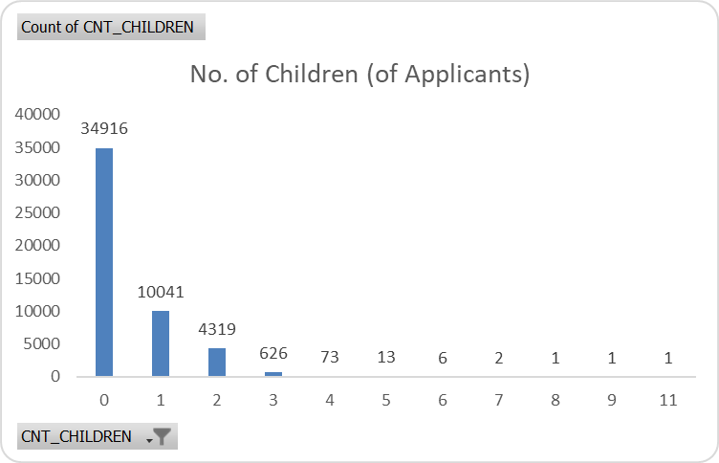
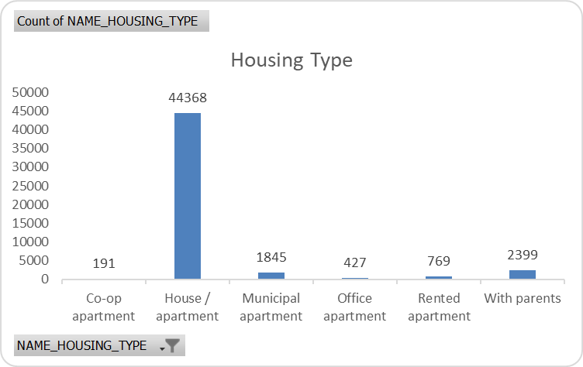
D. Perform Univariate, Segmented Univariate, and Bivariate Analysis
Most loan applicants do not have children.
Also, applicants seeking for a loan have House/apartment type as their living situation.
UNIVARIATE ANALYSIS

Slide 19
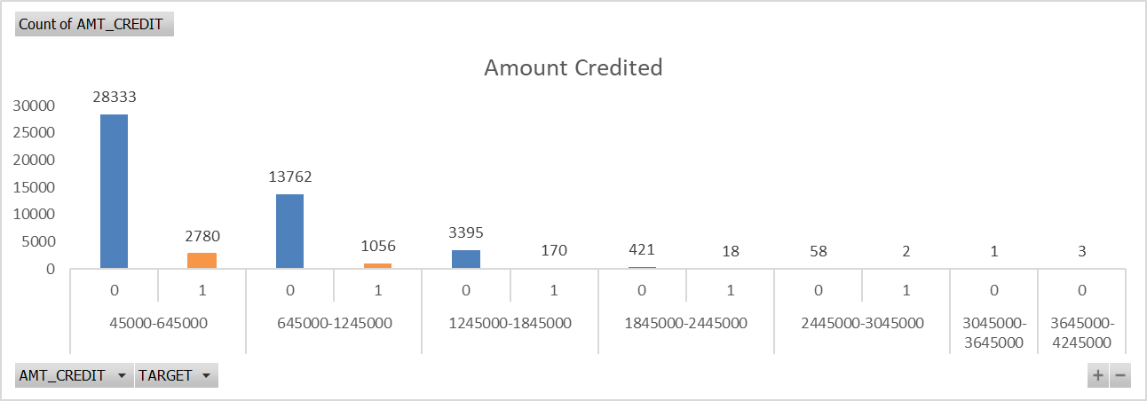
D. Perform Univariate, Segmented Univariate, and Bivariate Analysis
Most loan applicants do not have children.
Also, applicants seeking for a loan have House/apartment type as their living situation.

Slide 20
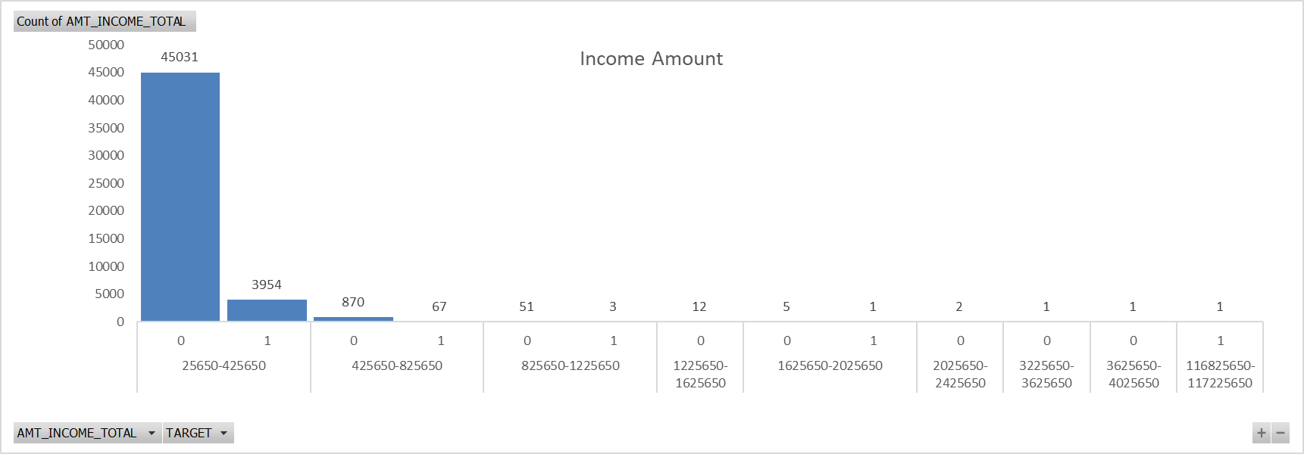
D. Perform Univariate, Segmented Univariate, and Bivariate Analysis
Most loan applicants do not have children.
Also, applicants seeking for a loan have House/apartment type as their living situation.

Slide 21
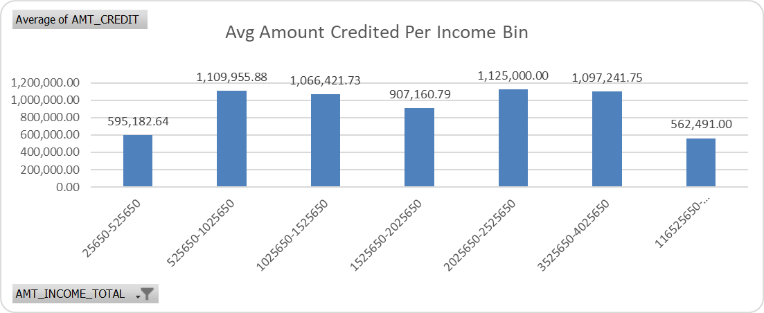
D. Perform Univariate, Segmented Univariate, and Bivariate Analysis
Most loan applicants do not have children.
Also, applicants seeking for a loan have House/apartment type as their living situation.

Slide 22
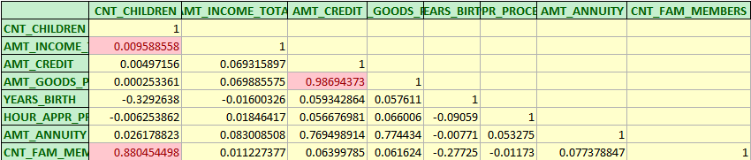
E. Top Correlations for Different Scenarios
Excel Hyperlink (CLICK HERE)
Top Correlations was observed between,
Income Amount and Count of Children
Count of Family Members and Count of Children
Goods Amount Price and Credit Amount
Annuity Amount and Income Amount

Slide 23
Tech-Stack Used
MS Excel 2019
Excel Hyperlink (CLICK HERE)
Ease of data management, gathering and performing operations on large dataset.
It is a useful tool to perform logical and statistical data analysis, and has a lot of features available for the same.
Ease of visually representing the analysis done with the help of various charts, pivot tables, etc.

Slide 24
Presenting the Insights
Excel Hyperlink (CLICK HERE)
Loan Repayers (as observed)
Couples with 1 child that have high income amount.
Customers with high income amount
Customers with education level of higher education or above.
Customers with high employment years.
Loan Defaulters (as observed)
Customers who are Single and unemployed.
Customers with high credit amount but low income amount.
Customers with high goods amount but low income amount.
Customers with house/apartment type housing and low income amount.

Slide 25
Result
Excel Hyperlink (CLICK HERE)
Importance of Data preparation
Presenting, Visualizing & Business Operations
Practical use of MS Excel
It is a crucial step of data analysis and half of the work can be made efficient during this step. Applying it practically, I understood how greatly it can lead to accuracy or inaccuracy of the data.
With the help of various graphs and statistical inferences using excel functions, it was very insightful how accurately the predictions could happen.
With the help of MS Excel, I was able to gain hands-on experience in how to present the findings that are implemented using logical operations and being able to communicate them in an easy to understand manner, both at the same time.

